Slide 1

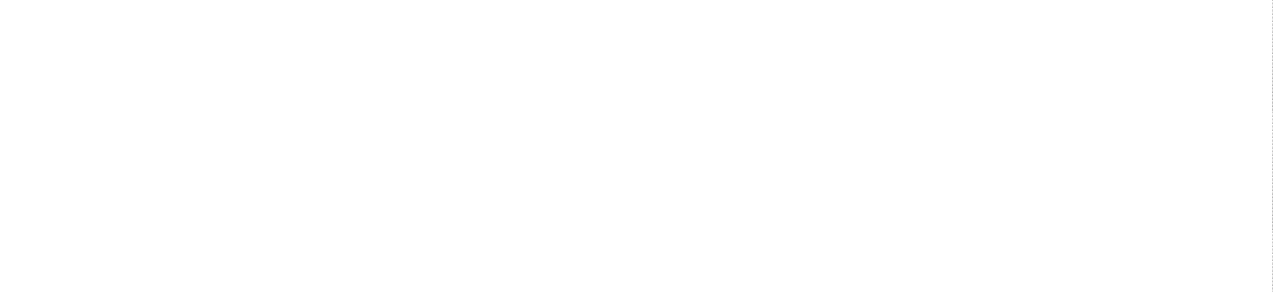

INSTITUTE: UIE (AIT-CSE)
CSS21: B.E. CSE (H) with specialization in Artificial Intelligence & Machine Learning
Advanced Machine Learning (20CSF-349)
Chapter 3.1.1: Tree Models
Lecture 31: Bootstrapping & Cross Validation
By: Mr. Siddharth Kumar
DISCOVER . LEARN . EMPOWER

Slide 2
Advanced Machine Learning
Course Outcome
CO | Title
1 | Have a good understanding of the fundamental issues and challenges of machine learning: data, model selection, model complexity, etc.
2 | Appreciate the underlying mathematical relationships within and across Machine Learning algorithms and the paradigms of supervised and un-supervised learning
3 | Design and implement various machine learning algorithms in a range of real-world applications.
4 | Design and evaluate intelligent expert models for perception and prediction using machine learning algorithms
5 | Analyze and make use of machine learning algorithms-based applications using performance

Slide 3
What Is Bootstrapping?
You might have heard the word bootstrapping used in business or finance parlance to describe the way that a startup was self-funded and built from the ground up by its founders. That meaning of bootstrapping stems from the phrase “pull yourself up by your bootstraps,” meaning to succeed on your own, without help from anyone else. It harkens back to frontier concepts of self-reliance.
However, according to the linguist Benjamin Zimmer, the true origin of the term bootstrapping was as an ironic statement used to imply that someone had claimed to do something that was actually impossible.
Luckily, in the context of statistics and data science, bootstrapping means something more specific and possible.
Bootstrapping is a method of inferring results for a population from results found on a collection of smaller random samples of that population, using replacement during the sampling process. This relates back to the original phrase because it belies the notion that the sample is only relying on smaller samples of itself to make calculations on, in order to draw conclusions for the larger population.

Slide 4
Replacement and Sampling
In order to better understand bootstrapping, it is helpful to understand what’s meant by replacement and the impact that replacement has on probability. Replacement means that every time an item is drawn from the pool, that same item remains a part of the sample pool that will be drawn from in the next instance. This rule continues to apply for all subsequent samples. If you were to have completely removed the first sample from the sampling pool without placing it back in and then drew the second sample, the items drawn in that sample would not be as likely to occur as the items in the first sample because the overall population would now be smaller.
In data science, the process is slightly more complex than just drawing names out of a hat. As you draw samples, you will make statistical calculations based on each one and then find the mean of that statistic across all samples. Once you have all of the statistics for each bootstrapped sample, you can plot them to understand the shape of your data and calculate bias, variance, hypothesis testing and confidence intervals.

Slide 5
Bootstrap Sampling in Machine Learning
Building and improving machine learning models make up a good portion of the work that data scientists do.
In a similar way to how bootstrapping is used to infer population results from averaged statistical measures calculated on multiple bags of random samples with replacement, it can be used to infer population results of machine learning models trained on random samples with replacement.
When a machine learning model is built based on bootstrapped data, the model is trained on the bootstrapped data and then tested on the out of bag (OOB) data.
The OOB is the portion of the original population that has never been selected in any of the random samples. Because the model has not seen this data before, the model’s quality can be accurately assessed by testing it. If the model performs well on this OOB test data, that indicates that it should also perform similarly well on new data that it’s later exposed to.

Slide 6
Here’s a formal definition of Bootstrap Sampling:
In statistics, Bootstrap Sampling is a method that involves drawing of sample data repeatedly with replacement from a data source to estimate a population parameter.
Wait – that’s too complex. Let’s break it down and understand the key terms:
Sampling: With respect to statistics, sampling is the process of selecting a subset of items from a vast collection of items (population) to estimate a certain characteristic of the entire population
Sampling with replacement: It means a data point in a drawn sample can reappear in future drawn samples as well
Parameter estimation: It is a method of estimating parameters for the population using samples. A parameter is a measurable characteristic associated with a population. For example, the average height of residents in a city, the count of red blood cells, etc.

Slide 7
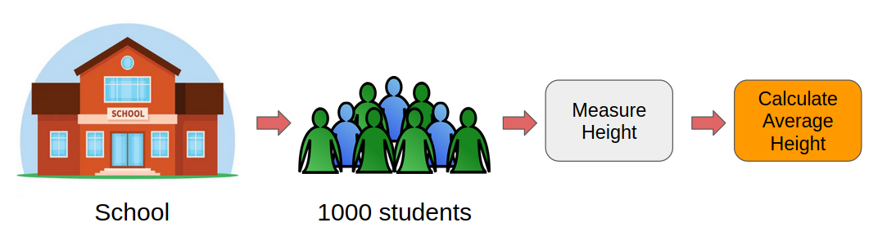
Why Do We Need Bootstrap Sampling?
This is a fundamental question I’ve seen machine learning enthusiasts grapple with. What is the point of Bootstrap Sampling? Where can you use it? Let me take an example to explain this.
Let’s say we want to find the mean height of all the students in a school (which has a total population of 1,000). So, how can we perform this task?
One approach is to measure the height of all the students and then compute the mean height. I’ve illustrated this process below:

Slide 8
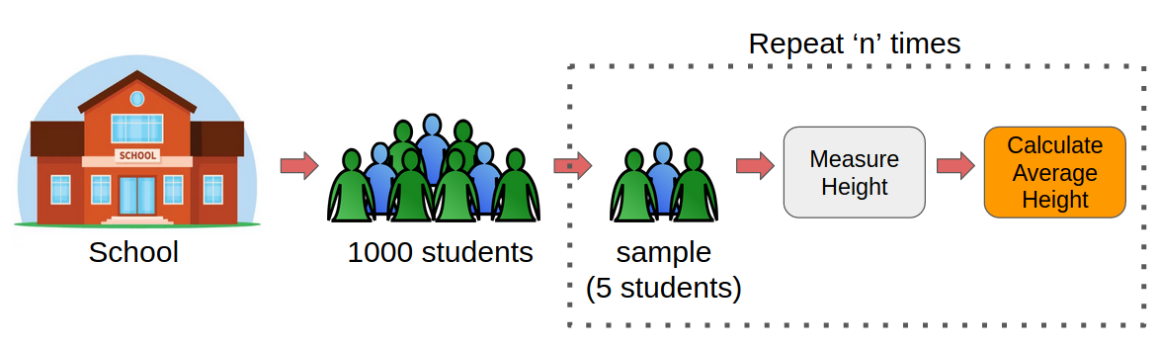
However, this would be a tedious task. Just think about it, we would have to individually measure the heights of 1,000 students and then compute the mean height. It will take days! We need a smarter approach here.
Instead of measuring the heights of all the students, we can draw a random sample of 5 students and measure their heights. We would repeat this process 20 times and then average the collected height data of 100 students (5 x 20). This average height would be an estimate of the mean height of all the students of the school. Pretty straightforward, right? This is the basic idea of Bootstrap Sampling.

Slide 9
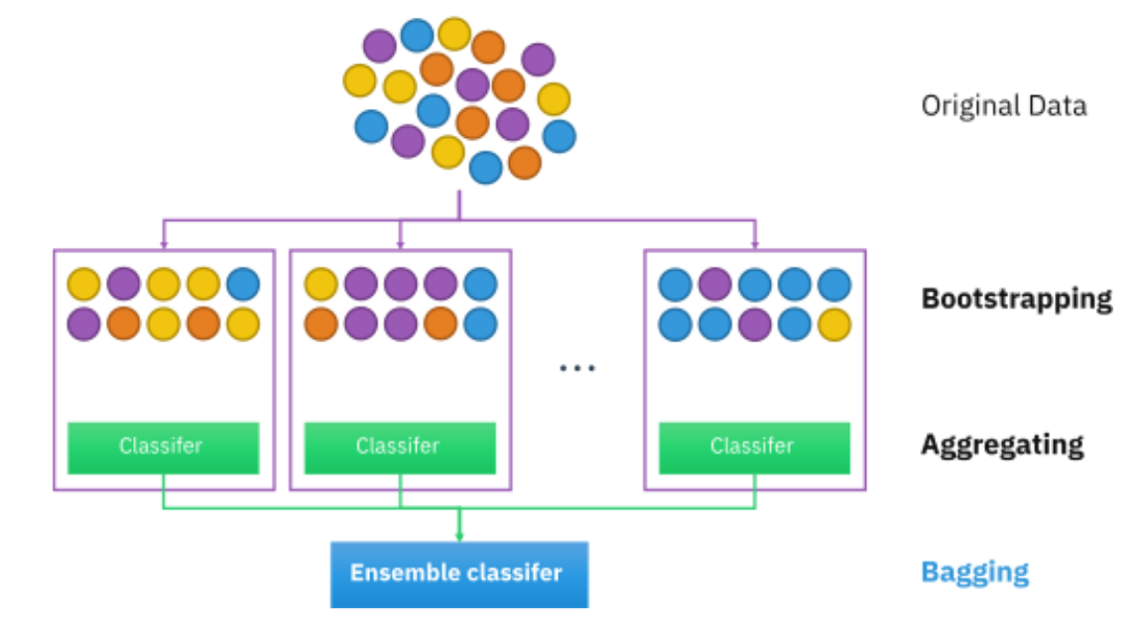
Bootstrap sampling is used in a machine learning ensemble algorithm called bootstrap aggregating (also called bagging). It helps in avoiding overfitting and improves the stability of machine learning algorithms.
In bagging, a certain number of equally sized subsets of a dataset are extracted with replacement. Then, a machine learning algorithm is applied to each of these subsets and the outputs are ensembled as I have illustrated in figure:

Slide 10
Cross Validation
In Machine Learning (ML), we couldn’t fit the model on the training data and can’t say that the model will work accurately for the real data. For this, we must assure that our model got the correct patterns from the data, and it is not getting up too much noise. For this purpose, we use the cross-validation technique.
Cross-validation is a technique for evaluating ML models by training several ML models on subsets of the available input data and evaluating them on the complementary subset of the data. Use cross-validation to detect overfitting, i.e., failing to generalize a pattern.
The three steps involved in cross-validation are as follows :
Reserve some portion of sample data-set.
Using the rest data-set train the model.
Test the model using the reserve portion of the data-set.

Slide 11
Methods of Cross Validation
Validation
In this method, we perform training on the 50% of the given data-set and rest 50% is used for the testing purpose. The major drawback of this method is that we perform training on the 50% of the dataset, it may possible that the remaining 50% of the data contains some important information which we are leaving while training our model i.e. higher bias.
LOOCV (Leave One Out Cross Validation)
In this method, we perform training on the whole data-set but leaves only one data-point of the available data-set and then iterates for each data-point. It has some advantages as well as disadvantages also.
An advantage of using this method is that we make use of all data points and hence it is low bias.
The major drawback of this method is that it leads to higher variation in the testing model as we are testing against one data point. If the data point is an outlier it can lead to higher variation. Another drawback is it takes a lot of execution time as it iterates over ‘the number of data points’ times.

Slide 12
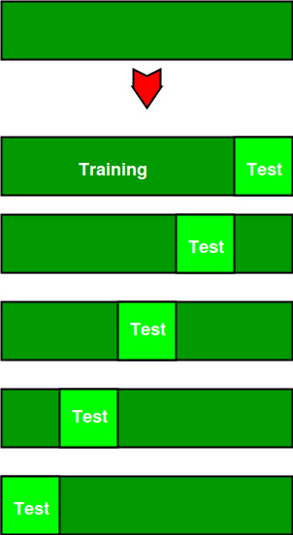
K-Fold Cross Validation
In this method, we split the data-set into k number of subsets(known as folds) then we perform training on the all the subsets but leave one(k-1) subset for the evaluation of the trained model. In this method, we iterate k times with a different subset reserved for testing purpose each time.
The diagram below shows an example of the training subsets and evaluation subsets generated in k-fold cross-validation. Here, we have total 25 instances. In first iteration we use the first 20 percent of data for evaluation, and the remaining 80 percent for training([1-5] testing and [5-25] training) while in the second iteration we use the second subset of 20 percent for evaluation, and the remaining three subsets of the data for training([5-10] testing and [1-5 and 10-25] training), and so on.

Slide 13
References
T1: Mitchell T.M., Machine Learning, McGraw Hill (1997).
T2: Andreas C. Miller, Sarah Guido, Introduction to Machine Learning with Python, O’REILLY (2001).
Notes:
Introduction to Cyber Security (simplilearn.com)

Slide 14

THANK YOU

